Slide 1
Food intolerances and allergies
Santa Casa da Misericórdia de Albufeira (SCMA)

Slide 2
Agenda
1. Definition of food allergies
2. Food allergy: symptoms
3. Food allergy: foods
4. Food intolerances
5. Food intolerance: symptoms
6. Treatment
7. Preparation and cooking: care to be taken

Slide 3
Food allergy: definition
Food allergy, is an exaggerated reaction in our immunological system against food proteins.
This food allergic reaction can happen following exposure to food by different routes:
  Ingestion;
  Contact with the skin or mucous membranes;
  Vapors from cooking food.
References: https://www.saudebemestar.pt/pt/medicina/alergologia/alergia-alimentar
https://www.hospitaldaluz.pt/pt/dicionario-de-saude/alergia-alimentar-e-intolerancia-alimentar

Slide 4
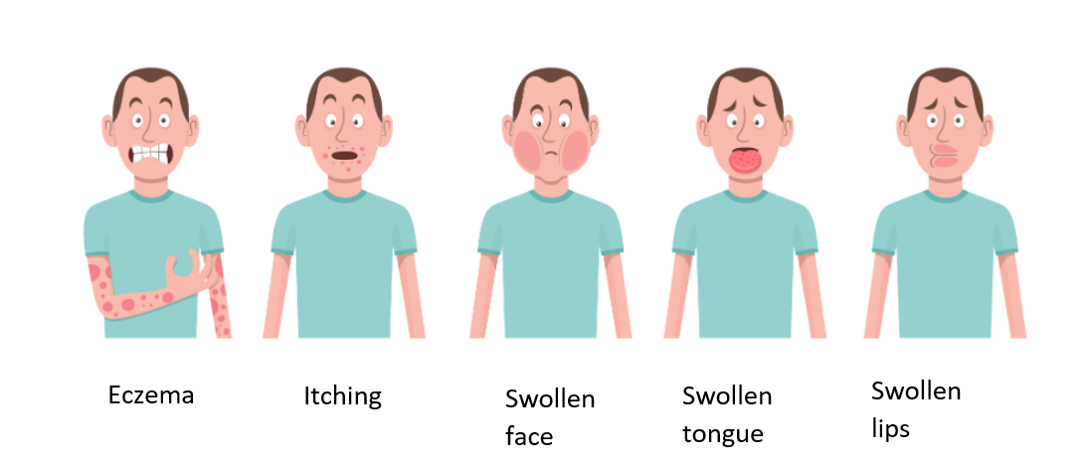
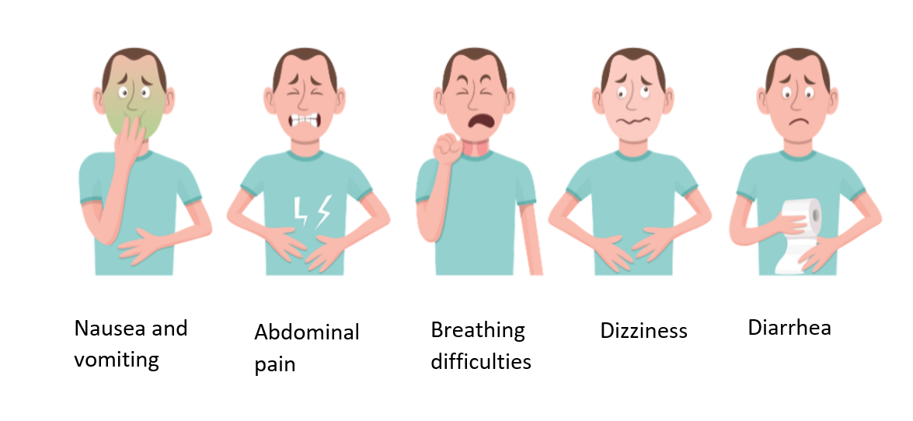
Food allergy: symptoms
References: https://www.news-medical.net/health/Food-Allergies-Explained.aspx

Slide 5
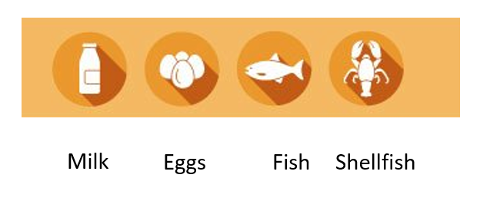
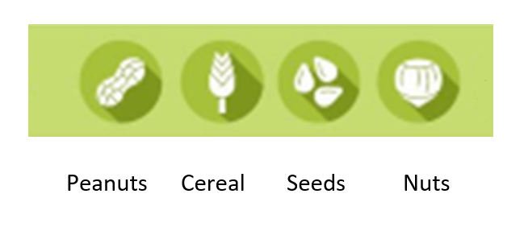
Food allergy: foods
Any food can trigger a food allergy. However, the food involved varies with the age of the patients and the eating habits of each family, which are closely related to the country in which they live.
References: https://www.saberviver.pt/bem-estar/saude/alergia-alimentar-sintomas-e-tratamentos/

Slide 6
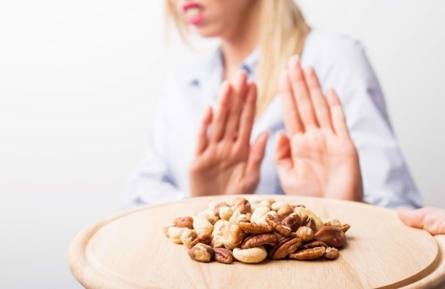
Food intolerances
Food intolerance is also an exaggerated reaction of the body to a particular food, but it is not the result of immunological mechanisms;
Food intolerance is related, for example, to the digestion or transformation of food in the body.
References: https://www.lusiadas.pt/blog/doencas/sintomas-tratamentos/intolerancia-alimentar-identifique-sintomas

Slide 7
Food intolerance: symptoms
Digestive complaints such as bloating, flatulence, irritable bowel, recurrent abdominal pain;
Headache
Joint pain
Fatigue and general malaise.
References: https://www.lusiadas.pt/blog/doencas/sintomas-tratamentos/intolerancia-alimentar-identifique-sintomas

Slide 8
Treatment
After confirmation of food allergy or intolerance, it is necessary, in either case, to exclude the food from the diet;
It forces you to carefully read the labels of pre-prepared food products, in order to identify potential hidden allergens.
References: https://www.hospitaldaluz.pt/pt/dicionario-de-saude/alergia-alimentar-e-intolerancia-alimentar

Slide 9
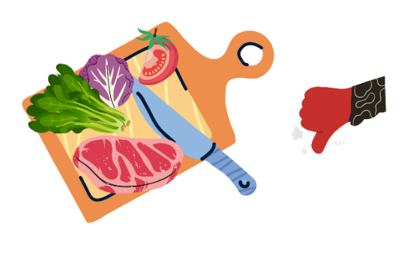
Preparation and cooking: care to be taken
Sometimes, the presence of the allergen occurs by cross-contamination in the production lines of processed foods;
Often a food that seems to be safe can trigger an allergic reaction just by coming into contact with other foods that have the allergen.
References: Pádua, I., Barros, R., Moreira, P. e Moreira, A. (2016). Alergia Alimentar na Restauração. Programa Nacional para a Promoção da Alimentação Saudável Direção-Geral da Saúde. Lisboa.

Slide 10
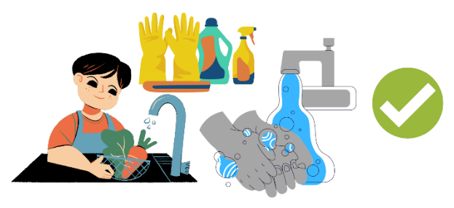
Preparation and cooking: care to be taken
Wash your hands properly between the various food handling steps;
Do not use the same utensils during the preparation, cooking, plating and distribution of meals (cutlery, mixers, mixers, cutting boards, plates, platters, pots and pans and others).
References: Pádua, I., Barros, R., Moreira, P. e Moreira, A. (2016). Alergia Alimentar na Restauração. Programa Nacional para a Promoção da Alimentação Saudável Direção-Geral da Saúde. Lisboa.

Slide 11
Preparation and cooking: care to be taken
Do not use the same frying oil or cooking water for different foods;
Do not use the same countertops or contact surfaces for handling food;
During meals, patients with food allergies should avoid sharing utensils (cutlery, plates, napkins, cups) or direct contact with potentially allergenic foods.
References: Pádua, I., Barros, R., Moreira, P. e Moreira, A. (2016). Alergia Alimentar na Restauração. Programa Nacional para a Promoção da Alimentação Saudável Direção-Geral da Saúde. Lisboa.

